Slide 1
Nature protection system and protected areas in Latvia
Gunta Gabrāne
Deputy Director General of Nature Conservation Agency of Latvia
2018

Slide 2
Dabas aizsardzības pārvalde -valsts iestāde
The Ministry of Environmental Protection and Regional Development
Supervised Institutions
Companies
State Environmental Service
Latvian Environment, Geology and Meteorology Centre
Administration of Latvian Environmental Protection Fund
Latvian Environmental Investment Fund
Environment State Bureau
Electronic Communications Office
Nature Conservation Agency
Natural History Museum of Latvia
National Botanic Garden of Latvia
Latvian Institute of Aquatic Ecology
State Regional Development Agency
Notes:
Dabas aizsardzības pārvalde ir Vides aizsardzības un reģionālās attīstības ministrijas pakļautībā esoša tiešās pārvaldes iestāde.

Slide 3
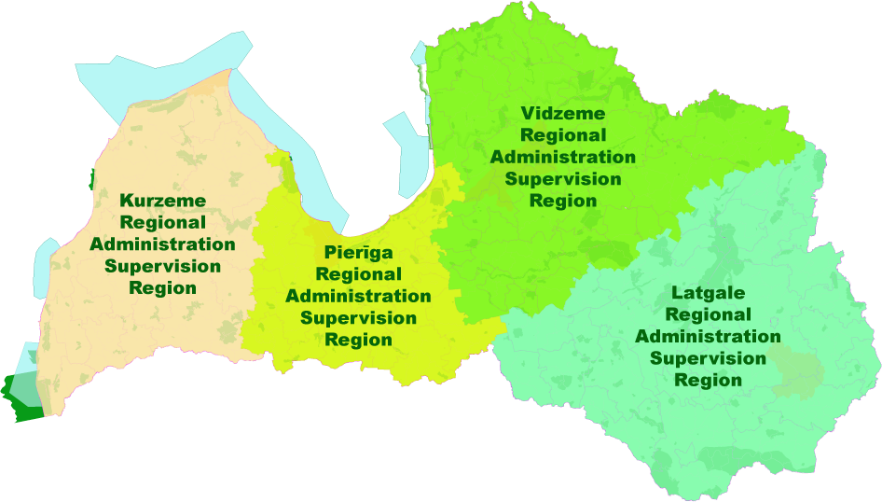
Specially Protected Nature Areas of Latvia – Management: 4
Nature Conservation
Current Situation & Future Vision

Slide 4

Specially protected natural areas
Specially protected natural areas are geographical territories, that are under special state-level protection, in order to safeguard and maintain biodiversity of nature – rare and typical ecosystems, habitats for rare species, landscapes, that are peculiar, beautiful and characteristic for Latvia, geological and geomorphological formations, as well as territories, significant for recreational and educational purposes.
Alltogether in Latvia there are 683 specially protected nature areas, (333 Natura 2000 sites).

Slide 5
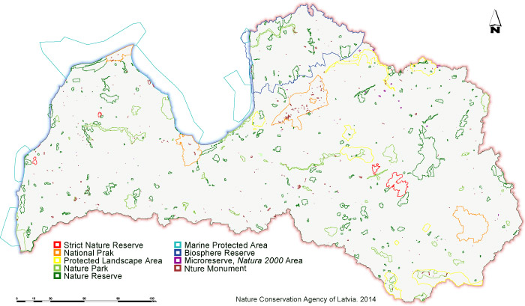

Slide 6
4 National parks
National parks are broad areas which are characterised by outstanding nature formations of national significance, landscapes and cultural heritage landscapes untouched by human activities or nearly natural, a diversity of biotopes, abundance of cultural and historical monuments, and peculiarities of cultural environment.
209600 ha

Slide 7
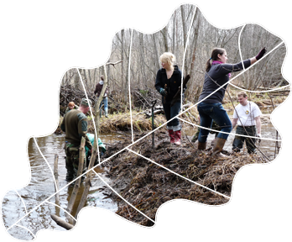
1 Biosphere reserve
Biosphere reserve are broad territory in which landscapes and ecosystems of international significance are located. The goal of establishing biosphere reserves is to ensure the preservation of natural diversity and to promote sustainable social and economic development of the territory.
474350 ha

Slide 8
42 Nature parks
Nature parks are territories that represent the natural, cultural and historical values of a particular area, and that are suitable for recreation, education and the instruction of society.
Organisation of recreation and economic activities in nature parks shall be carried out by ensuring the preservation of the natural, cultural and historical values located in such parks.
195616 ha

Slide 9
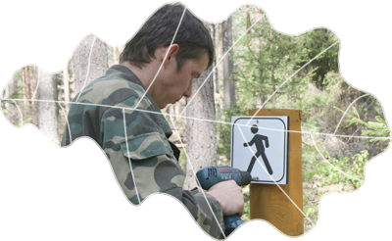
9 Protected landscape areas
Protected landscape areas are territories remarkable for original and diverse landscapes and special beauty.
The goals of such territories are to protect and preserve the cultural environment and landscapes characteristic of Latvia in all their diversity, as well as to ensure the preservation of environment appropriate for recreation of society and for tourism, and use of environment friendly management methods.
161361 ha

Slide 10
261 Nature reserves
Nature reserves are nature territories little transformed or transformed in varying degrees by human activities, which territories include habitats of specially protected wild plant and animal species, and specially protected biotopes.
223920 ha

Slide 11
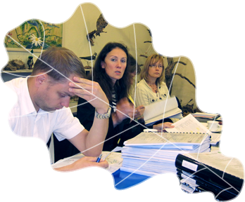
4 Strict nature reserves
Strict nature reserves are territories untouched by human activities or nearly natural, in which territories unhindered development of natural processes shall be ensured in order to protect and study rare or typical ecosystems and parts thereof. Strict nature reserves shall have zones in which all natural resources are completely excluded from economic and other activities.
25108 ha

Slide 12
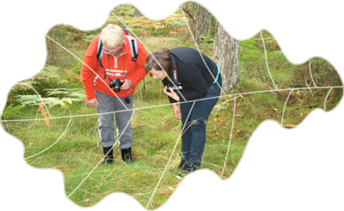
7 Marine protected areas
Marine protected areas are locations in the territorial sea, exclusive economic zone or continental shelf of the Republic of Latvia, which are established for the protection of protected biotopes and specially protected species habitat, as well as migratory bird significant feeding and wintering places.
1170868 ha

Slide 13
355 Nature monuments
Nature monuments are separate, isolated natural formations: protected trees, dendrological plantings, avenues, geological and geomorphological nature monuments and other natural rarities having scientific, cultural and historical, aesthetic or ecological value.
5274 ha

Slide 14

The Nature Conservation Agency of Latvia – Functions
Realization of state policy of nature conservation, species & biotopes protection
Coordination
of administration and management of specially protected areas
Implement
the functions of supervision of „The Convention on International Trade in Endangered Species of Wild Fauna and Flora” (CITES)
Maintain
records on scientific research in specially protected areas
Nature Conservation
Current Situation & Future Vision

Slide 15
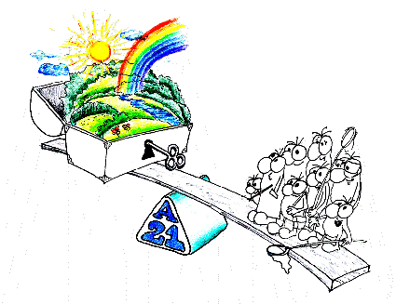
Function: Realization of state policy of nature conservation, species & biotopes protection
Nature Conservation
Current Situation & Future Vision

Slide 16
Function: Coordination of Administration and Management of Specially Protected Areas
to manage, maintaine and restore the protected habitats (forests, meadows, marshes and others) by carring out themselves or supervise the execution of the work, where contracts take place:
  grassland habitats – to cut grass, to cut bushies cutning, to dig ditches;
  freshwater habitats - to clear out streams, to tear down beaver dams
  marsh habitats - to build dams on ditches
to manage nature-based tourism infrastructure in most Latvian SPNA, including organizing and implementing co-operation with individuals, governments and businesses, foundations
to wage war against invasive species
to keep artificial nests of birds of prey
Nature Conservation
Current Situation & Future Vision

Slide 17
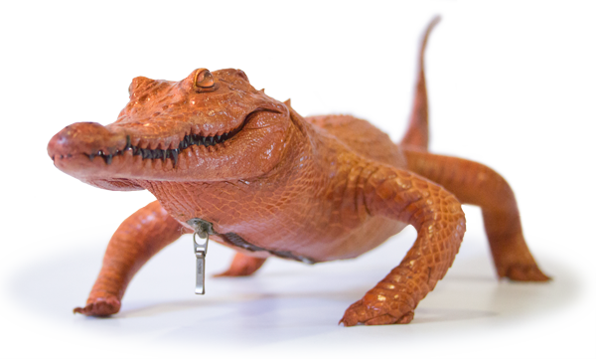
Function: Implement the functions of supervision of CITES
Latvian CITES Management Authority is the Nature Protection Agency, which is responsible for CITES and the EU regulations implementation, so its responsibilities include CITES permits and certificates, the rest of the CITES implementation institutions involved in the coordination of contacts with the Commission and the CITES Secretariat and
            the reporting of the CITES implementation success, the decision acceptance of the use of confiscated specimens, public information, etc.
Nature Conservation
Current Situation & Future Vision

Slide 18
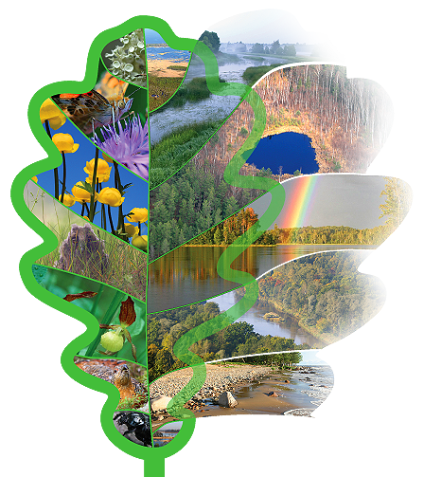
Function: Maintain
records on scientific research in specially protected areas
Data* of the Latvian specially protected natural territories micro-reserves, species and habitats in nature data management system OZOLS (Oak).
http://ozols.daba.gov.lv
* Information available in Latvian
Nature Conservation
Current Situation & Future Vision

Slide 19

The Nature Conservation Agency of Latvia – TASKS
plan
necessary conservation activities in protected nature areas;
issue
a statutory regulatory authorizations and reconciliations, including the Washington Convention "On International Trade in Endangered Species of Wild Fauna and Flora" (CITES) permits and certificates
organize
creating & renewing the species and habitat conservation plans, as well as to promote the implementation of the plans
promote
the public (including landowners) involvement in specially protected nature areas management
organize
optimal maintenance and renewal activities of a specially protected species, their habitats, protected habitats, as well as necessary measures
Nature Conservation
Current Situation & Future Vision

Slide 20
The Nature Conservation Agency of Latvia – TASKS
coordinate and carry out
scientific research and monitoring in the specially protected nature areas
organize & supervise
process of creating & renewing the nature conservation and restoration plans of specially protected nature areas, as well as to promote and coordinate the implementation of the plans
implement
international projects in environmental protection, as well as monitor their implementation
control
of the specially protected nature territories, as well as environmental protection regulations on compliance
provide
the public with information on special areas of conservation and the protection regime, to educate the public on matters of environmental protection
Nature Conservation
Current Situation & Future Vision

Slide 21
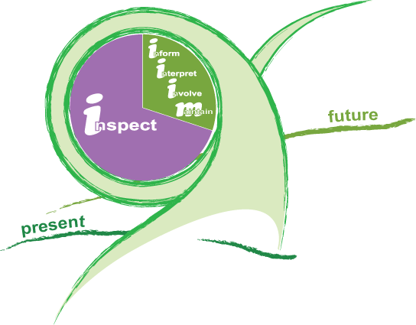
Daily Routine - Currently
inspecting
  to carry out the protection of protected species and habitats, including micro-reserves
informing, interpreting, involving, maintaining
  to promote and coordinate the conservation plan implementation
  to provide advice and information to local spatial plans, including land use plans
  to consult local residents, tourists, etc. about conservation issues
  to participate in creation, instalation and maintainance of information material (leaflets, newsletters, boards, information, direction and SPNA landmarks signs etc.)
  to implement the environmental education activities
  to maintain and restore nature tourism infrastructure (hiking routes, bicycle routes, boating and auto tourists rest places, view points etc.)
Nature Conservation
Current Situation & Future Vision

Slide 22
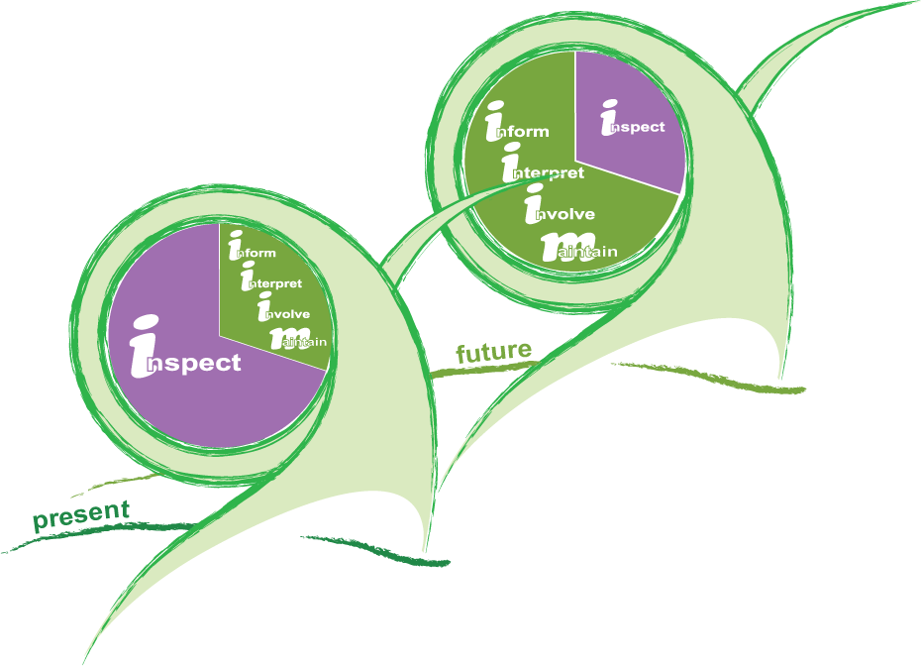
Daily Routine - Currently
Nature Conservation
Current Situation & Future Vision

Slide 23
Nature Conservation Agency of Republic of Latvia
Baznīcas iela 7, Sigulda, Latvia, LV2150
Phone: +371 67509545
info@daba.gov.lv
www.daba.gov.lv

